Slide 1

Introduction to Deep Learning with R
Ayoub Bagheri – a.bagheri@uu.nl
R café 02/2020

Slide 2


Slide 3
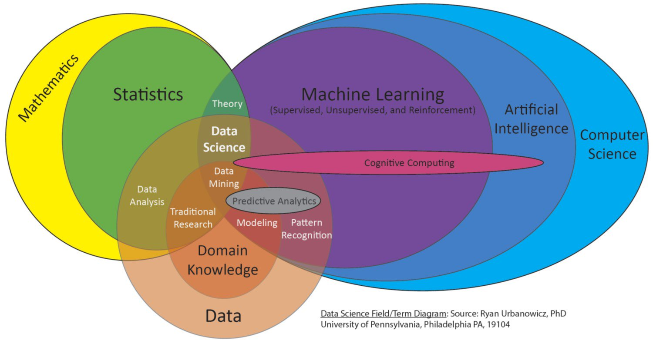

Slide 4

Neural Networks

Slide 5

Why is everyone talking about Deep Learning?
Deep learning:
Has won numerous pattern recognition competitions
Does so with minimal feature engineering
1960s
1980s
1990s
Since 1980s: Form of models hasn’t changed much, but lots of new tricks…
More hidden units
Better (online) optimization
New nonlinear functions (ReLUs)
Faster computers (CPUs and GPUs)
2006
2016
Notes:
TODO: Cut this.

Slide 6
Linear Regression
y
Output
θ₁
θ₂
θ₃
θ_{M}
x₁
x₂
x₃
…
x_{M}
Input

Slide 7
Neural Network Model
Inputs
Output
Age
34
.6
.4
.2
Σ
0.6
.1
.5
Gender
2
Σ
.3
.2
.8
.7
Σ
“Probability of beingAlive”
Stage
4
.2
Weights
Weights
Dependent variable
Prediction
Independent variables
Hidden Layer

Slide 8
“Combined logistic models”
Inputs
Output
Age
34
.6
.5
0.6
.1
Gender
2
Σ
.7
.8
“Probability of beingAlive”
Stage
4
Weights
Weights
Dependent variable
Prediction
Independent variables
Hidden Layer

Slide 9
Inputs
Output
Age
34
.2
.5
0.6
Gender
2
Σ
.3
.8
“Probability of beingAlive”
Stage
4
.2
Weights
Weights
Dependent variable
Prediction
Independent variables
Hidden Layer

Slide 10
Inputs
Output
Age
34
.6
.2
.5
0.6
.1
Gender
1
Σ
.3
.7
.8
“Probability of beingAlive”
Stage
4
.2
Weights
Weights
Dependent variable
Prediction
Independent variables
Hidden Layer

Slide 11
Different Levels of Abstraction
Output
y
Hidden Layer 3
c₁
c₂
…
c_{F}
Hidden Layer 2
b₁
b₂
…
b_{E}
Hidden Layer 1
a₁
a₂
…
a_{D}
Input
x₁
x₂
x₃
…
x_{M}
Example from Honglak Lee (NIPS 2010)

Slide 12
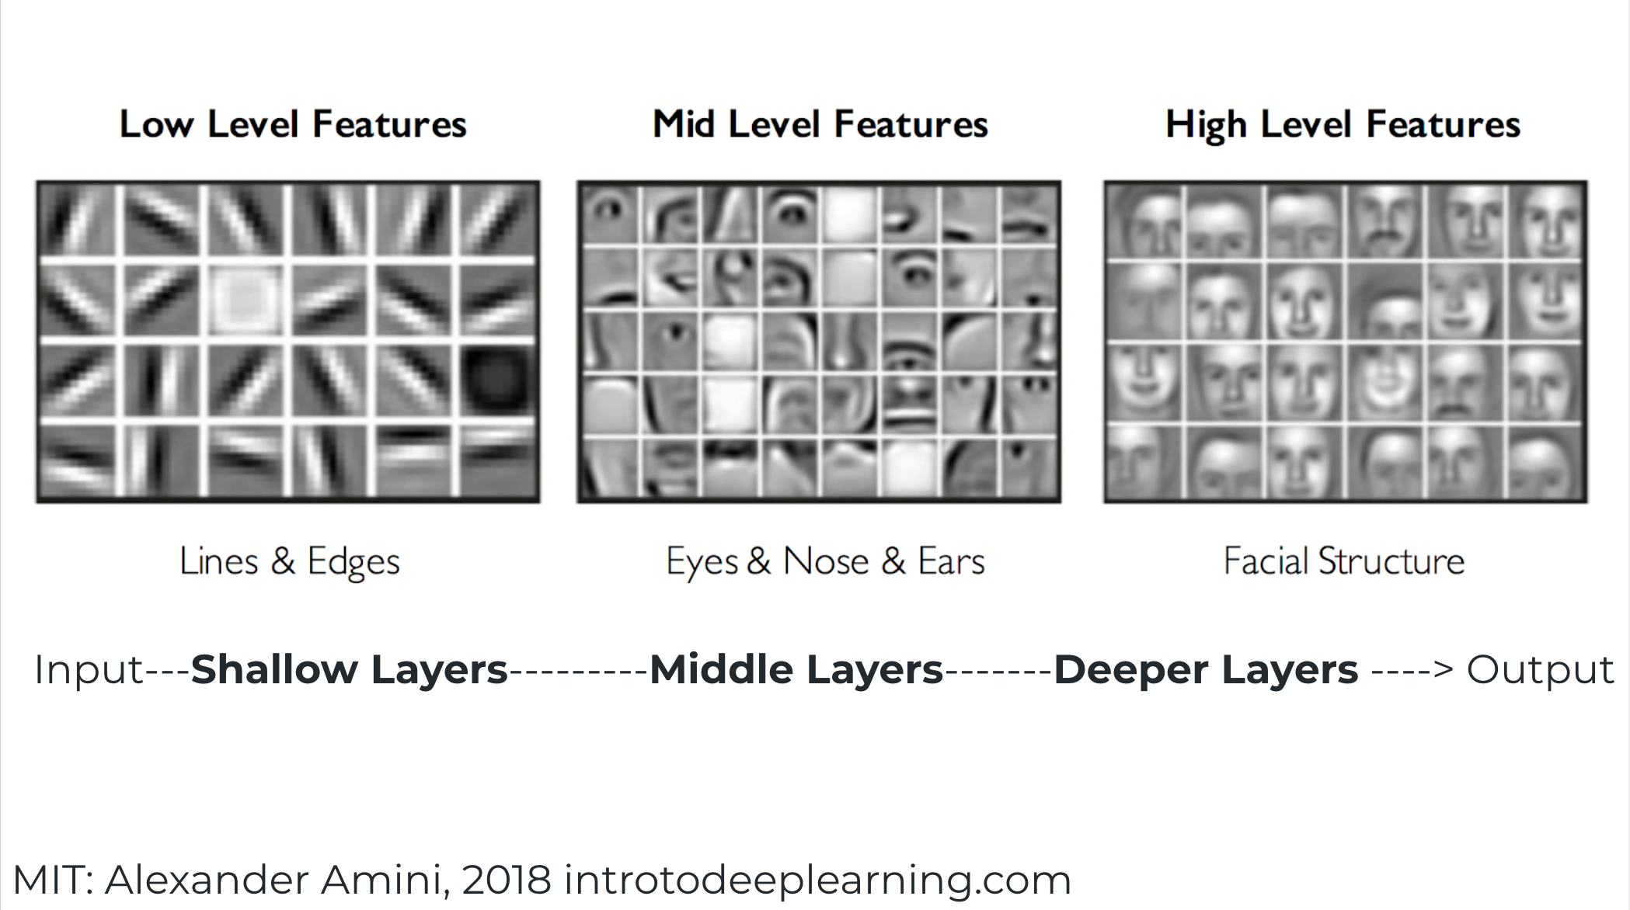

Slide 13

A Neural Network perspective
Data
Model
Prediction
Loss
5 convolutional layers
2 fully connected layers
-----------------------------------
100 convolutional layers
50 batch normalization layers
Softmax
---------------
Sigmoid
---------------
Linear etc.
Cross entropy
---------------
Euclidean
---------------
Contrastive

Slide 14
Anatomy of a neural network
Layers, which are combined into a network (or model)
The input data and corresponding targets
The loss function, which defines the feedback signal used for learning
The optimizer, which determines how learning proceeds

Slide 15
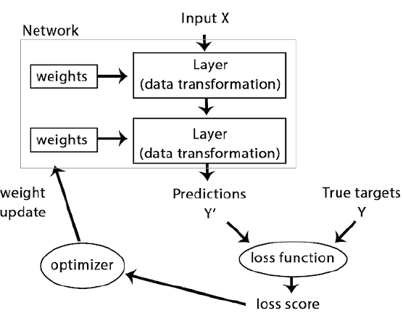

Slide 16


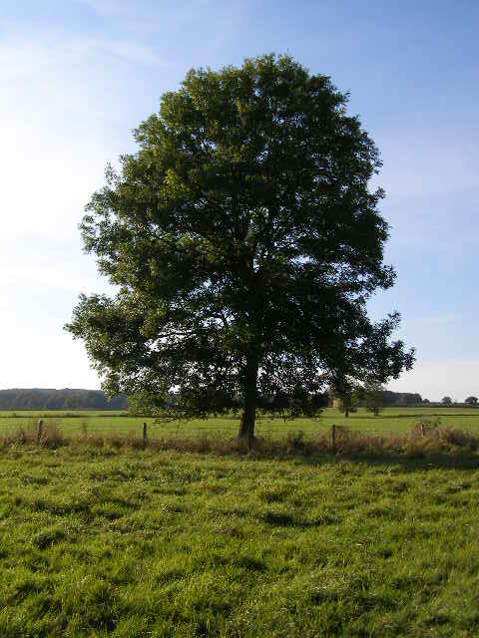
Recipe: Machine Learning
1. Given training data:
Face
Face
Not a face
2. Choose each of these:
Decision function
Loss function
Examples: Linear regression, Logistic regression, Neural Network
Examples: Mean-squared error, Cross Entropy

Slide 17
Machine Learning
3. Define goal:
4. Train with SGD:
(take small steps opposite the gradient)

Slide 18
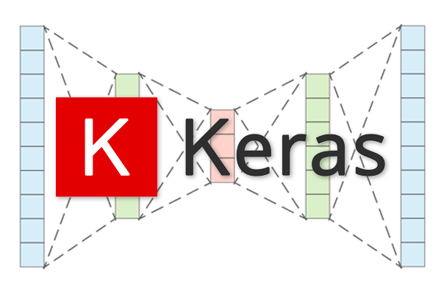
Keras
Among a bunch of deep learning frameworks,
Keras is probably the easiest to begin with:
TensorFlow, Keras, PyTorch, Chainer, Caffe, Theano, etc.
Keras is:
A high-level neural network API with support for both CPU and GPU.
Modular - Building models can be as simple as stacking layers.
Useful for fast prototyping as we can ignore implementation details of backpropagation,
Open source - Large community support.
Comprehensive - Contains implementations of popular networks, datasets, etc.
Has luxury of using any backend from TensorFlow, Theano, or CNTK without change in code.

Slide 19
Pipeline to Implement an NN-based Model in Keras
Specify the input size and output size.
Design and define the NN architecture.
Select the optimizer that performs gradient descent.
Select the loss function and train the network for an objective.
Select appropriate evaluation metrics for the problem you’re working on.
Prepare input and specify size
(Images, videos, text, audio, etc.)
Define the NN model
(Sequential or Functional style)
(MLP, CNN, RNN, etc.)
Optimizers
(SGD, RMSprop, Adam, etc.)
Loss function
(MSE, Cross entropy, Hinge, etc.)
Train and evaluate the model

Slide 20
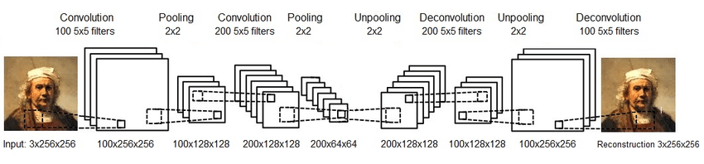
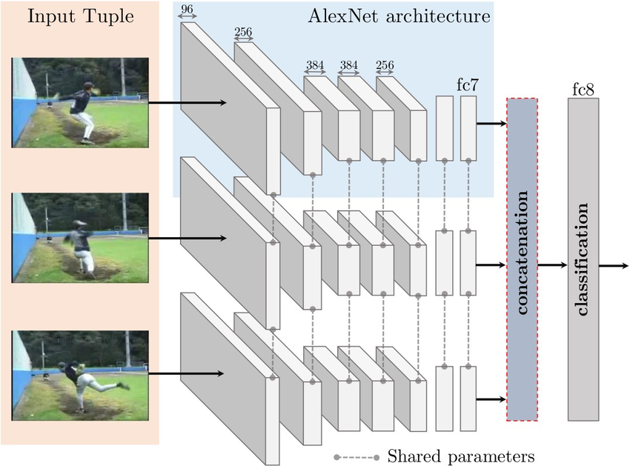
Keras Models
Sequential:
Linear stack of layers.
Useful for building:
Simple classification networks.
Encoder-Decoder networks.
Basically any single-flow network.
Under Keras as Sequential() class.
Functional:
Multi-input, multi-output models.
Supports, forking/branching of models.
Supports intermediate merging of models.
Under Keras as Model() class.

Slide 21

How to build a Deep Neural Network?
Invariant parameters
Input dimension
Output dimension
Semi-variable
Loss-function
Variable
# hidden layers
# hidden neurons
Activation functions
GD optimizations
Add-ons
Normalization
Regularization
Dropout

Slide 22
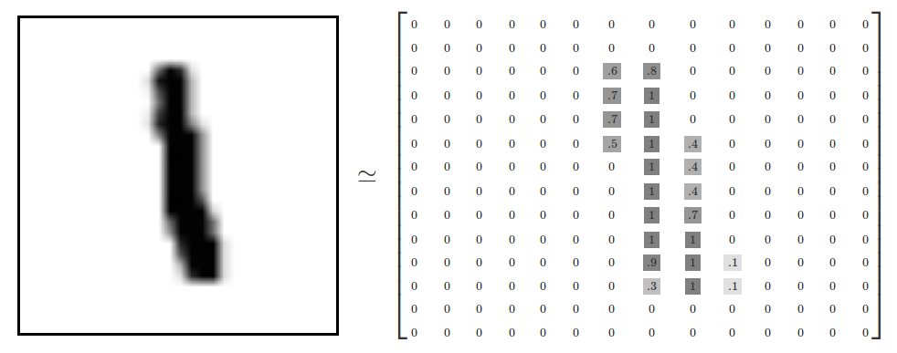
“Hello world”
Handwriting Digit Recognition
Machine
“1”
28 x 28
MNIST Data: http://yann.lecun.com/exdb/mnist/

Slide 23
Getting started
Load Data
Define Model
Compile Model
Fit Model
Evaluate Model

Slide 24
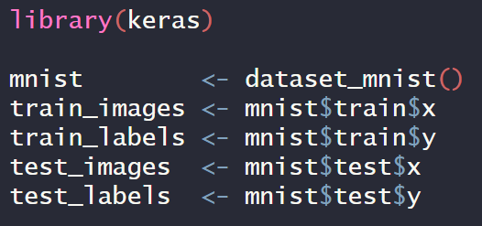
Load Data

Slide 25
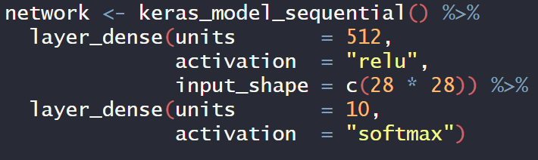
Define Model

Slide 26
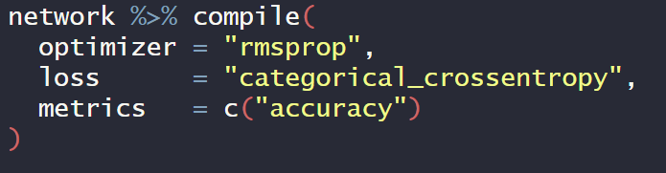
Compile Model

Slide 27
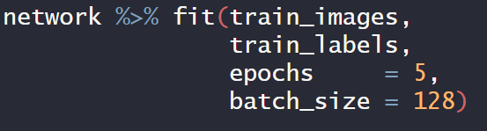
Fit Model

Slide 28
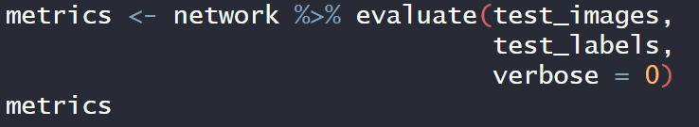
Evaluate Model

Slide 29
More examples
Classifying movie reviews as positive or negative (binary classification)
Classifying news wires by topic (multiclass classification)
Estimating the price of a house, given real-estate data (regression)

Slide 30
Playgrounds
Draw digits
https://okdalto.github.io/VisualizeMNIST_web/
A Neural Network Playground
http://playground.tensorflow.org
Deep learning reading group, Methodology & Statistics
Send an email: a.bagheri@uu.nl

Slide 31
Sequential Model Code
Import Sequential class from keras.models.
Stack layers in a sequential object using .add() method.
Only the first layer needs to know the expected input dimensions as next layers can infer shape from the previous layers.
Configure the learning process i.e. loss functions, optimizers, etc. using the .compile() method.
Train the model using .fit() method on training set tensors (can be np arrays).
from keras.models import Sequential
from keras.layers import Dense, Activation
model = Sequential()
# Dense is Keras lingo for a fully connected layer
model.add(Dense(units=64, input_dim=100))
model.add(Activation(‘relu’))
model.add(Dense(units=10))
model.add(Activation(‘Softmax’))
model.compile(loss=’categorical_crossentropy’,
optimizer=’sgd’,
metrics=[‘accuracy’])
model.fit(X_train, Y_train, epochs=5, batch_size=32)

Slide 32
Functional Model Code
Import Model class from keras.models.
Each layer has to explicitly return a tensor.
Manually pass the returned tensor to any compatible layer.
Flexibility at the cost of a bit of code complexity.
Explicitly mention model inputs and outputs.
.compile() and .fit() same as a Sequential model.
from keras.models import Model
from keras.layers import Input, Dense
inputs = Input(shape=(784,))
x = Dense(64, activation=’relu’)(inputs)
x = Dense(64, activation=’relu’)(x)
predictions = Dense(10, activation=’softmax’)(x)
model = Model(inputs=inputs, outputs=predictions)
model.compile(loss=’categorical_crossentropy’,
optimizer=’rmsprop’,
metrics=[‘accuracy’])
model.fit(X_train, Y_train, epochs=5, batch_size=32)

